Slide 1
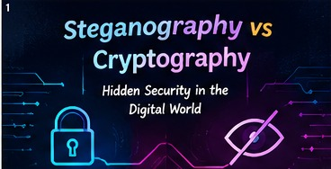
01/20
CSA5111-CRYPTOGRAPHY AND NETWORK SECURITY
Name: T S Sai Lahari
Reg no:192325137
STEGANOGRAPHY • CRYPTOGRAPHY • DIGITAL SECURITY

Slide 2
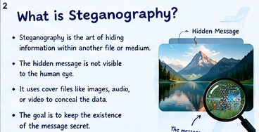
What Is Steganography?
Steganography means hiding information inside another file.
The carrier can be an image, audio clip, video, or document.
The hidden content may be text, a file, or a secret key.
To an observer, the carrier should look ordinary.
The main goal is to hide that communication is happening.
Methods include pixel changes and metadata-based hiding.
Good methods make changes difficult to notice.
Capacity and robustness depend on the carrier and method.
It is useful when secrecy of communication matters.
Concealment works best when it looks ordinary.
STEGANOGRAPHY • CRYPTOGRAPHY • DIGITAL SECURITY

Slide 3
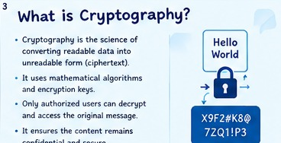
What Is Cryptography?
Cryptography protects information by transforming it.
Readable information is called plaintext.
An encryption algorithm and key produce ciphertext.
Decryption turns ciphertext back into readable information.
Modern systems rely on carefully designed algorithms.
Secret keys must be protected and managed safely.
Encryption can protect data in storage and in transit.
Other cryptographic tools support integrity and authentication.
The main goal is to keep content unreadable to outsiders.
Strong keys matter as much as strong algorithms.
STEGANOGRAPHY • CRYPTOGRAPHY • DIGITAL SECURITY

Slide 4
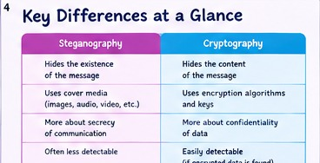
THE BIG DIFFERENCE
Steganography asks: can anyone tell a message is present?
Cryptography asks: can anyone understand the message?
Steganography embeds data inside an innocent-looking carrier.
Cryptography transforms data into an encoded form.
A hidden image may look normal but contain extra data.
Encrypted text may look obviously scrambled.
Steganography can attract less attention when successful.
Cryptography can protect large amounts of data efficiently.
The methods solve related but different security problems.
Different goals call for different defenses.
STEGANOGRAPHY • CRYPTOGRAPHY • DIGITAL SECURITY

Slide 5
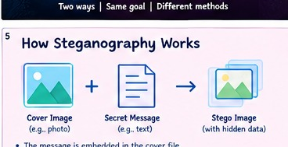
HOW STEGANOGRAPHY WORKS
First, choose a suitable cover file, such as a photo.
Prepare the secret message or file to be hidden.
Select a hiding method and, if needed, a secret key.
Embed the data into selected parts of the cover.
Save the result as a stego-object.
Share the stego-object through an appropriate channel.
The receiver applies the matching extraction method.
Lossy compression or editing may damage hidden content.
Always test the output and protect the extraction key.
A cover file carries a hidden payload.
STEGANOGRAPHY • CRYPTOGRAPHY • DIGITAL SECURITY

Slide 6
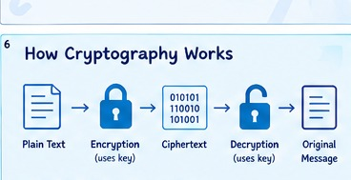
HOW CRYPTOGRAPHY WORKS
Start with plaintext, such as a message or document.
Choose a trusted encryption algorithm.
Use a key to encrypt the plaintext.
The output is ciphertext that should be unreadable.
Send or store the ciphertext securely.
The intended receiver obtains the correct decryption key.
Decryption restores the original plaintext.
Key exchange and key storage are crucial security steps.
Never invent your own encryption algorithm for real use.
Plaintext becomes ciphertext with a key.
STEGANOGRAPHY • CRYPTOGRAPHY • DIGITAL SECURITY

Slide 7
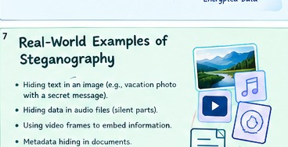
STEGANOGRAPHY IN REAL LIFE
A photograph can carry a small hidden message.
Audio files can conceal information in selected sound samples.
Video frames may carry hidden data across many images.
Digital watermarking can identify ownership of media.
Some systems embed tracking data in documents.
Researchers use steganography to study covert channels.
Legitimate uses include privacy, verification, and media protection.
Misuse can include hiding malicious instructions or stolen data.
Context and authorization matter when using these techniques.
Media can carry data beyond what meets the eye.
STEGANOGRAPHY • CRYPTOGRAPHY • DIGITAL SECURITY

Slide 8
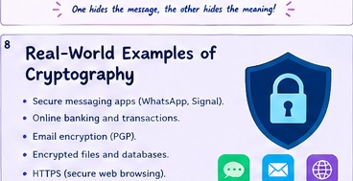
CRYPTOGRAPHY IN REAL LIFE
Secure messaging apps use encryption to protect conversations.
Online banking relies on cryptographic protocols.
HTTPS helps protect data exchanged with websites.
Encrypted backups help protect stored files.
Virtual private networks use cryptographic protections.
Digital signatures help verify who signed a document.
Password managers encrypt sensitive vault contents.
Organizations use encryption to reduce data exposure risks.
Security depends on correct configuration and key management.
Encryption protects data even when it is visible.
STEGANOGRAPHY • CRYPTOGRAPHY • DIGITAL SECURITY

Slide 9
STEGANOGRAPHY: ADVANTAGES & LIMITATIONS
ADVANTAGES
• Hides the existence of a message inside an ordinary-looking file.
• Supports images, audio, video, and document carriers.
• Can be useful for watermarking and media ownership.
• Can add concealment when used together with encryption.
LIMITATIONS
• Hidden capacity is often limited by the carrier.
• Compression, resizing, or editing may destroy hidden data.
• Detection tools can reveal suspicious patterns.
• It does not automatically encrypt the hidden message.
Conceals the message — but may be detected.
STEGANOGRAPHY • CRYPTOGRAPHY • DIGITAL SECURITY

Slide 10
CRYPTOGRAPHY: ADVANTAGES & LIMITATIONS
ADVANTAGES
• Protects the meaning of data from unauthorized readers.
• Strong algorithms can protect large files and communications.
• Supports secure banking, messaging, backups, and web traffic.
• Digital signatures can help verify authenticity and integrity.
LIMITATIONS
• Weak or stolen keys can undermine strong encryption.
• Lost keys may make protected data unrecoverable.
• Encryption does not prevent every malware or endpoint attack.
• It hides content, but not necessarily the fact that data exists.
Protects meaning — but depends on secure keys.
STEGANOGRAPHY • CRYPTOGRAPHY • DIGITAL SECURITY

Slide 11
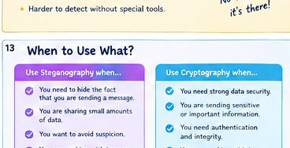
WHEN SHOULD YOU USE EACH?
Use steganography when hiding the presence of a message matters.
Use cryptography when protecting message content is the priority.
Use encryption for sensitive files, backups, and online traffic.
Consider steganography for authorized watermarking or covert research.
Use cryptography when data must remain confidential at scale.
Think about the likely attacker and detection capabilities.
Consider legal, ethical, and organizational requirements.
Check whether the method survives normal file processing.
Choose based on the security goal, not novelty alone.
Match the method to the real-world risk.
STEGANOGRAPHY • CRYPTOGRAPHY • DIGITAL SECURITY

Slide 12
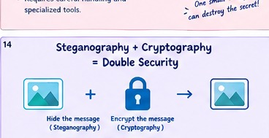
COMBINING BOTH: DOUBLE PROTECTION
First encrypt the message using a trusted algorithm.
Then embed the ciphertext inside a suitable cover file.
The carrier may look ordinary to a casual observer.
If the hidden data is found, encryption still protects its meaning.
The receiver extracts the ciphertext from the carrier.
The receiver then decrypts it using the correct key.
This adds concealment and confidentiality as separate layers.
The process also adds complexity and possible failure points.
Use established tools and test the full workflow.
Two layers can strengthen a security design.
STEGANOGRAPHY • CRYPTOGRAPHY • DIGITAL SECURITY

Slide 13
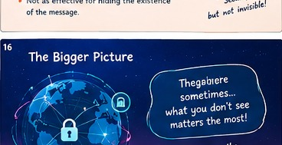
A BIGGER SECURITY PICTURE
Neither technique solves every security problem.
Confidentiality keeps information private.
Integrity helps ensure data has not been improperly changed.
Authentication helps confirm identities or message origins.
Availability helps keep systems and data accessible.
Steganography mainly focuses on concealment.
Cryptography can support confidentiality, integrity, and authentication.
Backups, access controls, updates, and training still matter.
Think in layers: people, process, and technology.
Think in layers, not in single solutions.
STEGANOGRAPHY • CRYPTOGRAPHY • DIGITAL SECURITY

Slide 14
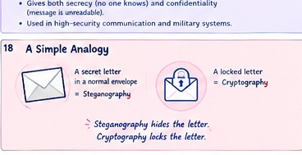
A SIMPLE ANALOGY
Imagine sending a note to a friend.
Steganography is like hiding the note inside a postcard picture.
The postcard looks ordinary to people who see it.
Cryptography is like writing the note in a secret code.
People may see the coded note but cannot read its meaning.
Combining both is like coding the note and hiding it in the picture.
The postcard hides the note's presence.
The code protects the note's meaning.
This analogy captures the central difference clearly.
A postcard can hide; a code can protect.
STEGANOGRAPHY • CRYPTOGRAPHY • DIGITAL SECURITY

Slide 15
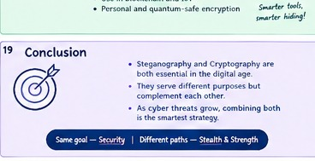
CONCLUSION
Steganography and cryptography protect digital information differently.
One conceals communication; the other transforms its content.
Each has distinct strengths, limitations, and use cases.
Real-world systems often need more than one defense.
Encryption should use reputable, modern algorithms.
Steganography should be tested against realistic detection methods.
Protect keys, devices, accounts, and communication channels.
Use security tools legally, ethically, and with authorization.
Choose the method that matches your security objective.
Choose the tool that fits your objective.
STEGANOGRAPHY • CRYPTOGRAPHY • DIGITAL SECURITY

Slide 16

Thank You
Stay curious. Stay secure.
STEGANOGRAPHY • CRYPTOGRAPHY • DIGITAL SECURITY

